Slide 1


Big Data Infrastructure
Session 11: Beyond MapReduce — Stream Processing
Jimmy Lin
University of Maryland
Monday, April 20, 2015
This work is licensed under a Creative Commons Attribution-Noncommercial-Share Alike 3.0 United States See http://creativecommons.org/licenses/by-nc-sa/3.0/us/ for details

Slide 2
Today’s Agenda
Basics of stream processing
Sampling and hashing
Architectures for stream processing
Twitter case study

Slide 3
What is a data stream?
Sequence of items:
Structured (e.g., tuples)
Ordered (implicitly or timestamped)
Arriving continuously at high volumes
Not possible to store entirely
Sometimes not possible to even examine all items

Slide 4
What to do with data streams?
Network traffic monitoring
Datacenter telemetry monitoring
Sensor networks monitoring
Credit card fraud detection
Stock market analysis
Online mining of click streams
Monitoring social media streams

Slide 5
What’s the scale? Packet data streams
Single 2 Gb/sec link; say avg. packet size is 50 bytes
Number of packets/sec = 5 million
Time per packet = 0.2 microseconds
If we only capture header information per packet: source/destination IP, time, no. of bytes, etc. – at least 10 bytes
50 MB per second
4+ TB per day
Per link!
What if you wanted to do deep-packet inspection?
Source: Minos Garofalakis, Berkeley CS 286

Slide 6
DBMS
What are the top (most frequent) 1000 (source, dest) pairs seen by R1 over the last month?
Off-line analysis – Data access is slow, expensive
Network Operations
Center (NOC)
How many distinct (source, dest) pairs have been seen by both R1 and R2 but not R3?
Set-Expression Query
BGP
R1
R2
Peer
R3
Converged IP/MPLS
Network
SELECT COUNT (R1.source, R1.dest)
FROM R1, R2
WHERE R1.source = R2.source
Enterprise Networks
DSL/Cable
Networks
PSTN
SQL Join Query
Source: Minos Garofalakis, Berkeley CS 286

Slide 7
Common Architecture
queries
DSMS
data feeds
DBMS
DSMS
data streams
queries
Data stream management system (DSMS) at observation points
Voluminous streams-in, reduced streams-out
Database management system (DBMS)
Outputs of DSMS can be treated as data feeds to databases
Source: Peter Bonz

Slide 8
DBMS vs. DSMS
DBMS
Model: persistent relations
Relation: tuple set/bag
Data update: modifications
Query: transient
Query answer: exact
Query evaluation: arbitrary
Query plan: fixed
DSMS
Model: (mostly) transient relations
Relation: tuple sequence
Data update: appends
Query: persistent
Query answer: approximate
Query evaluation: one pass
Query plan: adaptive
Source: Peter Bonz

Slide 9
What makes it hard?
Intrinsic challenges:
Volume
Velocity
Limited storage
Strict latency requirements
Out-of-order delivery
System challenges:
Load balancing
Unreliable message delivery
Fault-tolerance
Consistency semantics (lossy, exactly once, at least once, etc.)

Slide 10
What exactly do you do?
“Standard” relational operations:
Select
Project
Transform (i.e., apply custom UDF)
Group by
Join
Aggregations
What else do you need to make this “work”?

Slide 11
Issues of Semantics
Group by… aggregate
When do you stop grouping and start aggregating?
Joining a stream and a static source
Simple lookup
Joining two streams
How long do you wait for the join key in the other stream?
Joining two streams, group by and aggregation
When do you stop joining?
What’s the solution?

Slide 12
Windows
Mechanism for extracting finite relations from an infinite stream
Windows restrict processing scope:
Windows based on ordering attributes (e.g., time)
Windows based on item (record) counts
Windows based on explicit markers (e.g., punctuations)
Variants (e.g., some semantic partitioning constraint)

Slide 13
Windows on Ordering Attributes
Assumes the existence of an attribute that defines the order of stream elements (e.g., time)
Let T be the window size in units of the ordering attribute
t₁
t₂
t₃
t₄
t₁'
t₂’
t₃’
t₄’
sliding window
t_{i}’ – t_{i} = T
t₁
t₂
t₃
tumbling window
t_{i+1} – t_{i} = T
Source: Peter Bonz

Slide 14
Windows on Counts
Window of size N elements (sliding, tumbling) over the stream
Challenges:
Problematic with non-unique timestamps: non-deterministic output
Unpredictable window size (and storage requirements)
t₁
t₂
t₁'
t₃
t₂’
t₃’
t₄’
Source: Peter Bonz

Slide 15
Windows from “Punctuations”
Application-inserted “end-of-processing”
Example: stream of actions… “end of user session”
Properties
Advantage: application-controlled semantics
Disadvantage: unpredictable window size (too large or too small)

Slide 16
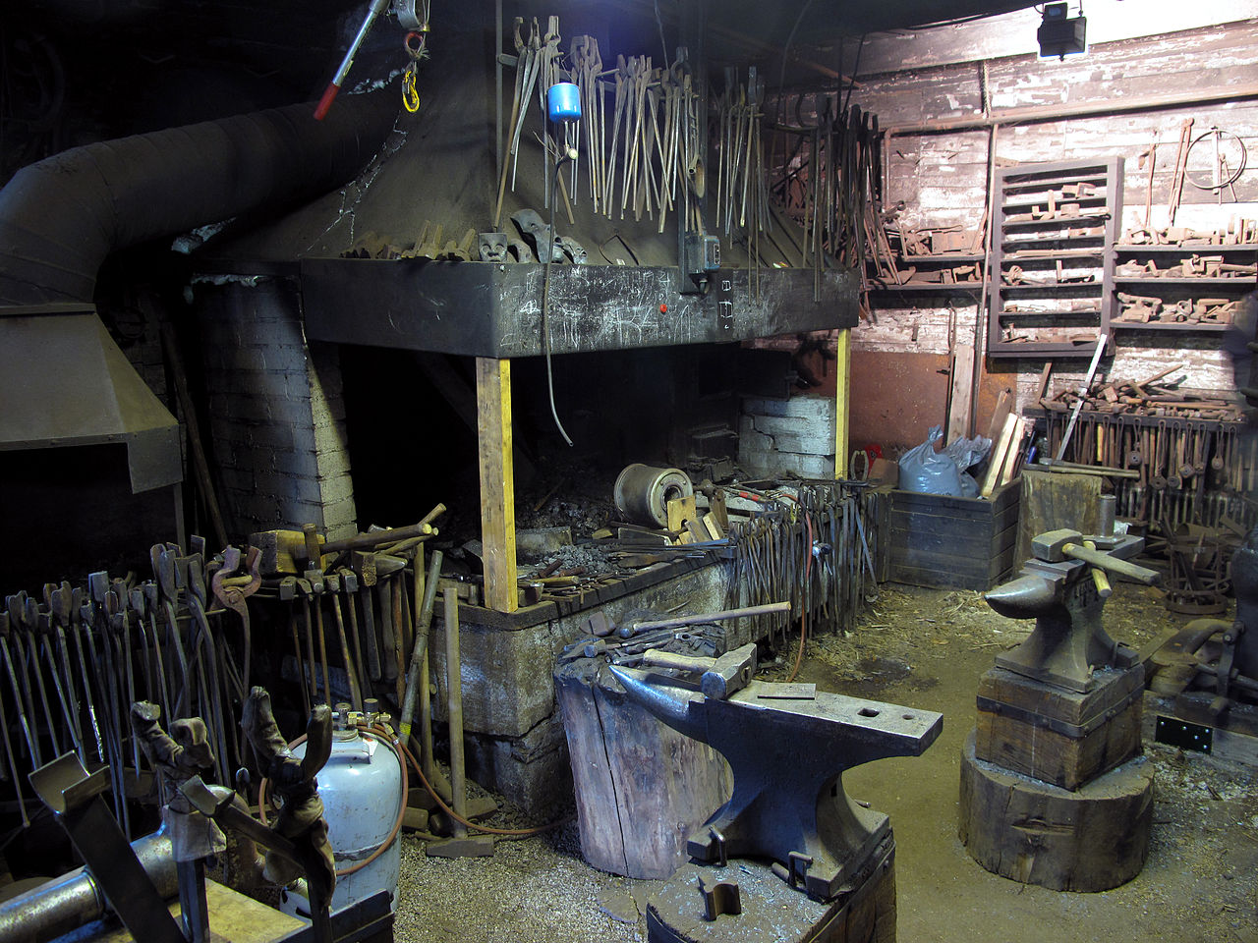
Common Techniques
Source: Wikipedia (Forge)

Slide 17
“Hello World” Stream Processing
Problem:
Count the frequency of items in the stream
Why?
Take some action when frequency exceeds a threshold
Data mining: raw counts → co-occurring counts → association rules

Slide 18
The Raw Stream…
Source: Peter Bonz

Slide 19
Divide Into Windows…
Source: Peter Bonz

Slide 20
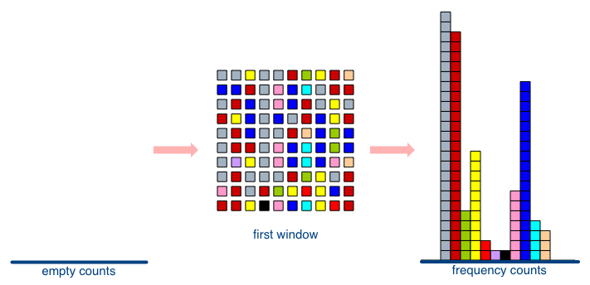
First Window
Source: Peter Bonz

Slide 21
Second Window
Source: Peter Bonz

Slide 22
Window Counting
What’s the issue?
What’s the solution?
Lessons learned?
Solutions are approximate (or lossy)

Slide 23
General Strategies
Sampling
Hashing

Slide 24
Reservoir Sampling
Task: select s elements from a stream of size N with uniform probability
N can be very very large
We might not even know what N is! (infinite stream)
Solution: Reservoir sampling
Store first s elements
For the k-th element thereafter, keep with probability s/k (randomly discard an existing element)
Example: s = 10
Keep first 10 elements
11th element: keep with 10/11
12th element: keep with 10/12
…

Slide 25
Reservoir Sampling: How does it work?
Example: s = 10
Keep first 10 elements
11th element: keep with 10/11
General case: at the (k + 1)th element
Probability of selecting each item up until now is s/k
Probability existing element is replaced: s/(k+1) × 1/s = 1/(k + 1)
Probability existing element is not replaced: k/(k + 1)
Probability each element survives to (k + 1)th round: (s/k) × k/(k + 1) = s/(k + 1)
If we decide to keep it: sampled uniformly by definition
probability existing item discarded: 10/11 × 1/10 = 1/11
probability existing item survives: 10/11

Slide 26
Hashing for Three Common Tasks
Cardinality estimation
What’s the cardinality of set S?
How many unique visitors to this page?
Set membership
Is x a member of set S?
Has this user seen this ad before?
Frequency estimation
How many times have we observed x?
How many queries has this user issued?
HashSet
HLL counter
HashSet
Bloom Filter
HashMap
CMS

Slide 27
HyperLogLog Counter
Task: cardinality estimation of set
size() → number of unique elements in the set
Observation: hash each item and examine the hash code
On expectation, 1/2 of the hash codes will start with 1
On expectation, 1/4 of the hash codes will start with 01
On expectation, 1/8 of the hash codes will start with 001
On expectation, 1/16 of the hash codes will start with 0001
…
How do we take advantage of this observation?

Slide 28
Bloom Filters
Task: keep track of set membership
put(x) → insert x into the set
contains(x) → yes if x is a member of the set
Components
m-bit bit vector
k hash functions: h₁ … h_{k}
0
0
0
0
0
0
0
0
0
0
0
0

Slide 29
Bloom Filters: put
put
x
h₁(x) = 2
h₂(x) = 5
h₃(x) = 11
0
0
0
0
0
0
0
0
0
0
0
0

Slide 30
Bloom Filters: put
put
x
0
1
0
0
1
0
0
0
0
0
1
0

Slide 31
Bloom Filters: contains
contains
x
h₁(x) = 2
h₂(x) = 5
h₃(x) = 11
0
1
0
0
1
0
0
0
0
0
1
0

Slide 32
Bloom Filters: contains
contains
x
h₁(x) = 2
h₂(x) = 5
h₃(x) = 11
A[h₁(x)]
A[h₂(x)]
AND = YES
A[h₃(x)]
0
1
0
0
1
0
0
0
0
0
1
0

Slide 33
Bloom Filters: contains
contains
y
h₁(y) = 2
h₂(y) = 6
h₃(y) = 9
0
1
0
0
1
0
0
0
0
0
1
0

Slide 34
Bloom Filters: contains
contains
y
h₁(y) = 2
h₂(y) = 6
h₃(y) = 9
A[h₁(y)]
A[h₂(y)]
AND = NO
A[h₃(y)]
0
1
0
0
1
0
0
0
0
0
1
0
What’s going on here?

Slide 35
Bloom Filters
Error properties: contains(x)
False positives possible
No false negatives
Usage:
Constraints: capacity, error probability
Tunable parameters: size of bit vector m, number of hash functions k

Slide 36
Count-Min Sketches
Task: frequency estimation
put(x) → increment count of x by one
get(x) → returns the frequency of x
Components
k hash functions: h₁ … h_{k}
m by k array of counters
m
0
0
0
0
0
0
0
0
0
0
0
0
0
0
0
0
0
0
0
0
0
0
0
0
k
0
0
0
0
0
0
0
0
0
0
0
0
0
0
0
0
0
0
0
0
0
0
0
0

Slide 37
Count-Min Sketches: put
put
x
h₁(x) = 2
h₂(x) = 5
h₃(x) = 11
h₄(x) = 4
0
0
0
0
0
0
0
0
0
0
0
0
0
0
0
0
0
0
0
0
0
0
0
0
0
0
0
0
0
0
0
0
0
0
0
0
0
0
0
0
0
0
0
0
0
0
0
0

Slide 38
Count-Min Sketches: put
put
x
0
1
0
0
0
0
0
0
0
0
0
0
0
0
0
0
1
0
0
0
0
0
0
0
0
0
0
0
0
0
0
0
0
0
1
0
0
0
0
1
0
0
0
0
0
0
0
0

Slide 39
Count-Min Sketches: put
put
x
h₁(x) = 2
h₂(x) = 5
h₃(x) = 11
h₄(x) = 4
0
1
0
0
0
0
0
0
0
0
0
0
0
0
0
0
1
0
0
0
0
0
0
0
0
0
0
0
0
0
0
0
0
0
1
0
0
0
0
1
0
0
0
0
0
0
0
0

Slide 40
Count-Min Sketches: put
put
x
0
2
0
0
0
0
0
0
0
0
0
0
0
0
0
0
2
0
0
0
0
0
0
0
0
0
0
0
0
0
0
0
0
0
2
0
0
0
0
2
0
0
0
0
0
0
0
0

Slide 41
Count-Min Sketches: put
put
y
h₁(y) = 6
h₂(y) = 5
h₃(y) = 12
h₄(y) = 2
0
2
0
0
0
0
0
0
0
0
0
0
0
0
0
0
2
0
0
0
0
0
0
0
0
0
0
0
0
0
0
0
0
0
2
0
0
0
0
2
0
0
0
0
0
0
0
0

Slide 42
Count-Min Sketches: put
put
y
0
2
0
0
0
1
0
0
0
0
0
0
0
0
0
0
3
0
0
0
0
0
0
0
0
0
0
0
0
0
0
0
0
0
2
1
0
1
0
2
0
0
0
0
0
0
0
0

Slide 43
Count-Min Sketches: get
get
x
h₁(x) = 2
h₂(x) = 5
h₃(x) = 11
h₄(x) = 4
0
2
0
0
0
1
0
0
0
0
0
0
0
0
0
0
3
0
0
0
0
0
0
0
0
0
0
0
0
0
0
0
0
0
2
1
0
1
0
2
0
0
0
0
0
0
0
0

Slide 44
Count-Min Sketches: get
get
x
h₁(x) = 2
h₂(x) = 5
h₃(x) = 11
h₄(x) = 4
A[h₁(x)]
A[h₂(x)]
MIN = 2
A[h₃(x)]
A[h₄(x)]
0
2
0
0
0
1
0
0
0
0
0
0
0
0
0
0
3
0
0
0
0
0
0
0
0
0
0
0
0
0
0
0
0
0
2
1
0
1
0
2
0
0
0
0
0
0
0
0

Slide 45
Count-Min Sketches: get
get
y
h₁(y) = 6
h₂(y) = 5
h₃(y) = 12
h₄(y) = 2
0
2
0
0
0
1
0
0
0
0
0
0
0
0
0
0
3
0
0
0
0
0
0
0
0
0
0
0
0
0
0
0
0
0
2
1
0
1
0
2
0
0
0
0
0
0
0
0

Slide 46
Count-Min Sketches: get
get
y
h₁(y) = 6
h₂(y) = 5
h₃(y) = 12
h₄(y) = 2
A[h₁(y)]
A[h₂(y)]
MIN = 1
A[h₃(y)]
A[h₄(y)]
0
2
0
0
0
1
0
0
0
0
0
0
0
0
0
0
3
0
0
0
0
0
0
0
0
0
0
0
0
0
0
0
0
0
2
1
0
1
0
2
0
0
0
0
0
0
0
0

Slide 47
Count-Min Sketches
Error properties:
Reasonable estimation of heavy-hitters
Frequent over-estimation of tail
Usage:
Constraints: number of distinct events, distribution of events, error bounds
Tunable parameters: number of counters m, number of hash functions k, size of counters

Slide 48
Three Common Tasks
Cardinality estimation
What’s the cardinality of set S?
How many unique visitors to this page?
Set membership
Is x a member of set S?
Has this user seen this ad before?
Frequency estimation
How many times have we observed x?
How many queries has this user issued?
HashSet
HLL counter
HashSet
Bloom Filter
HashMap
CMS

Slide 49
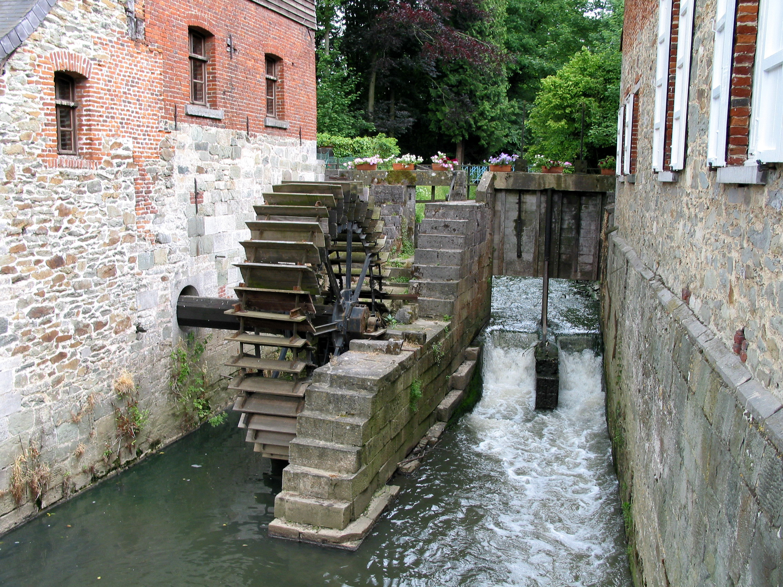
Stream Processing Architectures
Source: Wikipedia (River)

Slide 50
Typical Architecture
Source: Carney et al. (VLDB 2002)

Slide 51
Typical Architecture
Source: Carney et al. (VLDB 2002)

Slide 52
Typical Distributed Architecture
Source: Zaharia et al. (SOSP 2013)

Slide 53
What makes it hard?
Intrinsic challenges:
Volume
Velocity
Limited storage
Strict latency requirements
Out-of-order delivery
System challenges:
Load balancing
Unreliable message delivery
Fault-tolerance
Consistency semantics (lossy, exactly once, at least once, etc.)

Slide 54
Example Operator Graph
Source: Gedik et al. (SIGMOD 2008)

Slide 55
Storm
Open-source real-time distributed stream processing system
Started at BackType
BackType acquired by Twitter in 2011
Now an Apache project
Storm aspires to be the Hadoop of real-time processing!

Slide 56
Storm Topologies
Storm topologies = “job”
Once started, runs continuously until killed
A Storm topology is a computation graph
Graph contains nodes and edges
Nodes hold processing logic (i.e., transformation over its input)
Directed edges indicate communication between nodes

Slide 57
Streams, Spouts, and Bolts
Streams
The basic collection abstraction: an unbounded sequence of tuples
Streams are transformed by the processing elements of a topology
spout
spout
stream
bolt
bolt
bolt
Spouts
Stream generators
May propagate a single stream to multiple consumers
bolt
bolt
spout
Bolts
Subscribe to streams
Streams transformers
Process incoming streams and produce new ones
stream
stream
bolt
bolt

Slide 58
Storm Architecture

Slide 59
Stream Groupings
Bolts are executed by multiple workers in parallel
When a bolt emits a tuple, where should it go?
Stream groupings:
Shuffle grouping: round-robin
Field grouping: based on data value

Slide 60
Storm: Example
// instantiate a new topology
TopologyBuilder builder = new TopologyBuilder();
// set up a new spout with five tasks
builder.setSpout("spout", new RandomSentenceSpout(), 5);
// the sentence splitter bolt with eight tasks
builder.setBolt("split", new SplitSentence(), 8)
.shuffleGrouping("spout"); // shuffle grouping for the ouput
// word counter with twelve tasks
builder.setBolt("count", new WordCount(), 12)
.fieldsGrouping("split", new Fields("word")); // field grouping
// new configuration
Config conf = new Config();
// set the number of workers for the topology; the 5x8x12=480 tasks
// will be allocated round-robin to the three workers, each task
// running as a separate thread
conf.setNumWorkers(3);
// submit the topology to the cluster
StormSubmitter.submitTopology("word-count", conf, builder.createTopology());

Slide 61
Spark Streaming
Discretized stream processing: run a streaming computation as a series of very small, deterministic batch jobs
Continuous Operator Model
Discretized Streams
Source: Zaharia et al. (SOSP 2013)

Slide 62
Spark and Spark Streaming
Source: Zaharia et al. (SOSP 2013)

Slide 63
Today’s Agenda
Basics of stream processing
Sampling and hashing
Architectures for stream processing
Twitter case study

Slide 64

Questions?
Source: Wikipedia (Japanese rock garden)

